Slide 1

Voice Agent
Machine Learning Engineer in the Generative AI Era

Slide 2
Lecture Overview
What is a Voice Agent?
Introduction to GPT4o-Realtime
Chained Methods vs End-to-End Models
How ASR Works & Popular Models (related to Project 3)
How TTS Works & Popular Models
Common Audio Data Processing Pipelines (e.g., Emilia)

Slide 3
What is a Voice Agent?
Definition: Conversational AI that interacts via spoken language
Uses speech input (microphone) and speech output (speaker)
Applications: Virtual assistants, customer support bots, smart home devices
Challenges: Real-time processing, noise robustness, naturalness

Slide 4
GPT4o-Realtime for Voice Agents
GPT4o-Realtime: Large language model optimized for low-latency streaming
Enables interactive, natural conversations with voice input/output
Supports multi-modal (audio + text) integration
Advantage: Real-time understanding and generation with low delay

Slide 5
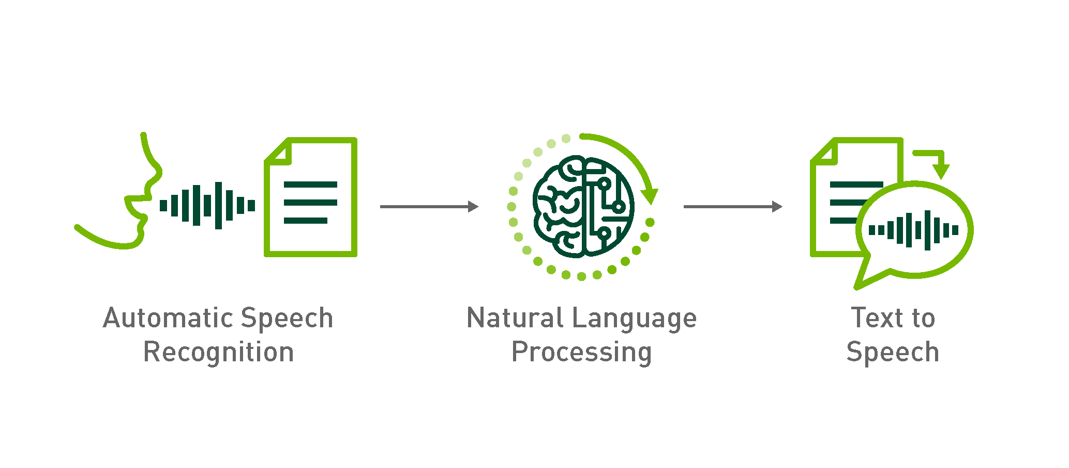
Chained Method vs End-to-End Models
Chained Method:
Sequence of models: ASR → LLM → TTS
Pros: Modular, easy to debug and improve separately
Cons: Accumulated latency, error propagation between modules
End-to-End Models:
Single neural model directly mapping speech to speech or text to speech
Pros: Potentially lower latency, holistic optimization
Cons: Harder to train, requires massive data

Slide 6

How ASR Works (Automatic Speech Recognition)
Converts speech audio into text transcription
Pipeline components:
Feature extraction (MFCC, Mel-spectrogram)
Acoustic model (neural network, e.g., RNN, Transformer)
Language model (contextual understanding)
Decoder (beam search to find best transcription)
Popular ASR models/tools:
Whisper (OpenAI)
Wav2Vec 2.0 (Facebook)
Kaldi (traditional toolkit)

Slide 7
Popular ASR Models and Their Use Cases
Model | Strengths | Use Cases
Whisper | Open-source, multilingual, robust | Podcast transcription, general purpose
Wav2Vec 2.0 | Self-supervised pretraining, accurate | Industry-scale ASR, customization
Google Cloud Speech | Cloud-based, scalable | Real-time apps, global languages

Slide 8

How TTS Works (Text-to-Speech)
Converts text into human-like speech audio
Pipeline components:
Text analysis and normalization
Acoustic model generates speech features (mel spectrogram)
Vocoder converts features to waveform audio
Popular TTS architectures:
Tacotron 2 + WaveGlow / HiFi-GAN
FastSpeech 2
VITS (End-to-End TTS)

Slide 9
Popular TTS Models and Their Use Cases
Model | Strengths | Use Cases
Tacotron 2 | Natural prosody, widely used | Virtual assistants, audiobooks
FastSpeech 2 | Fast inference, controllable prosody | Real-time TTS applications
VITS | End-to-end, high quality | Voice cloning, expressive TTS

Slide 10
Common Audio Data Processing Pipelines
Typical audio pipeline stages:
Audio capture and noise reduction
Feature extraction (e.g., Mel-spectrogram)
Data augmentation (speed perturbation, noise injection)
Model input preparation

Slide 11
Summary & Key Takeaways
Voice agents combine ASR, LLM, and TTS for natural spoken interaction
Modular chained approach is flexible but may add latency
End-to-end models are promising but resource intensive
Understanding ASR and TTS pipelines is crucial for building voice agents
Audio data processing pipelines like Emilia standardize workflows for training

Slide 12
Thank You

